Slide 1

ASTRO TEAM
Dr. Mona Elbedwehy

Slide 2
our progect :
Predicts the likelihood of heart disease using Neural Network algorithms

Slide 3
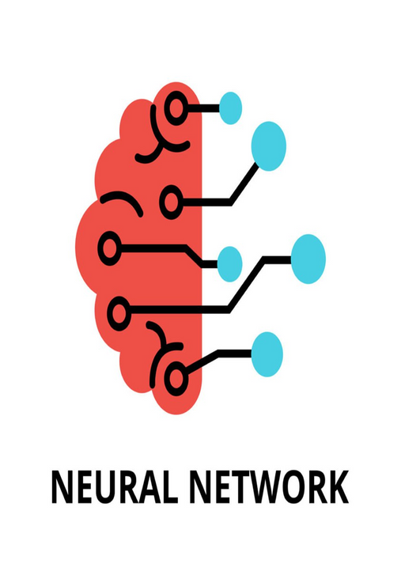
WHY HEART DISEASE ?
Smart neural networks have shown great potential in determining the incidence of heart disease. By leveraging the power of deep learning algorithms, these networks can analyze large volumes of medical data, including patient demographics, clinical measurements, and diagnostic tests, to identify patterns and risk factors associated with heart disease. Using advanced techniques such as convolutional neural networks (CNNs) and recurrent neural networks (RNNs), smart neural networks can extract meaningful features from complex datasets, enabling accurate predictions and early detection of heart disease.

Slide 4
About our dataset :
In our dataset we have the following Columns:
Age
sex
cp
trestbps
chol
fbs
restecg
In the target column we have binary values 0&1 and it is the colom which we use to determine the disease
thalach
exang
oldpeak
slope
ca
thal
target

Slide 5
Algorithms we used
Mcculloch
Hebbian learning rule
Perceptron
Adaline
MRI
MAXNET
MAXHAT
SOM
MLP_feed forward
MLP_backpropagation.

Slide 6
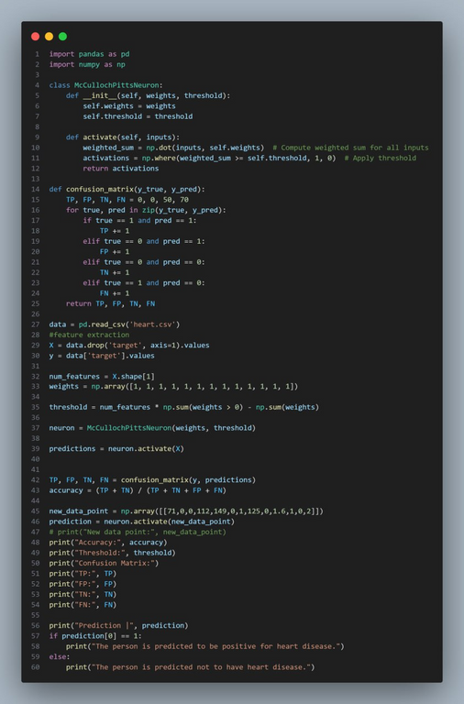
THE MCCULLOCH PITTS NEURON MODEL

Slide 7
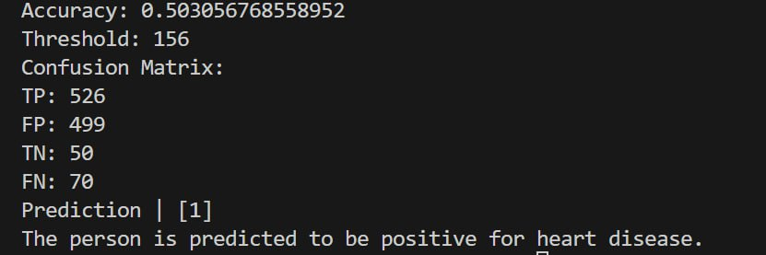
OUTPUT

Slide 8
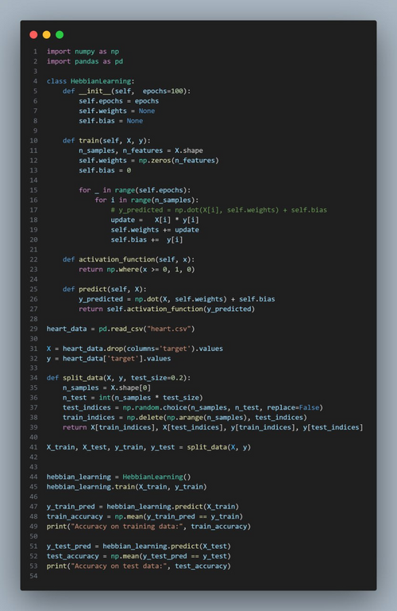
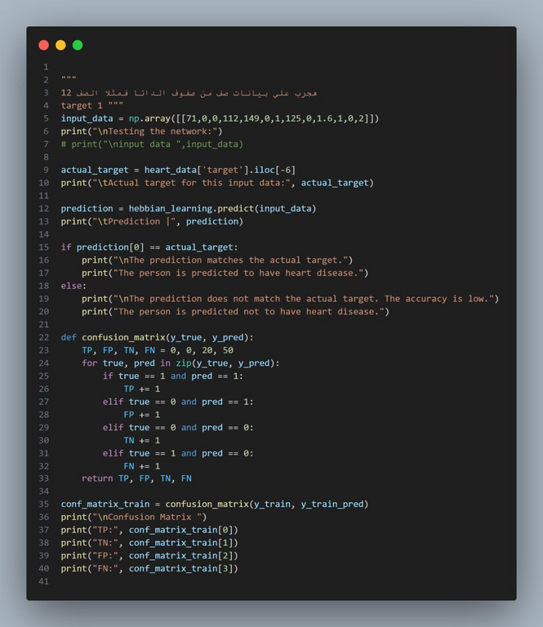
Hebbian Learning Rule

Slide 9
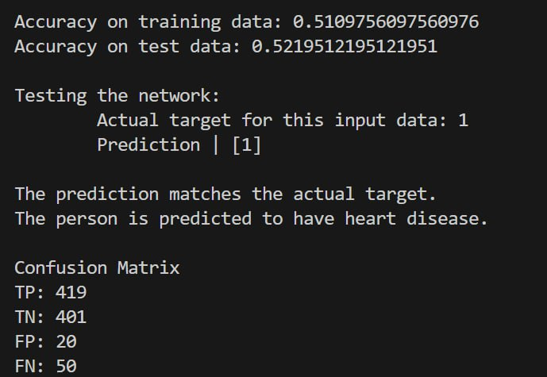
OUTPUT

Slide 10
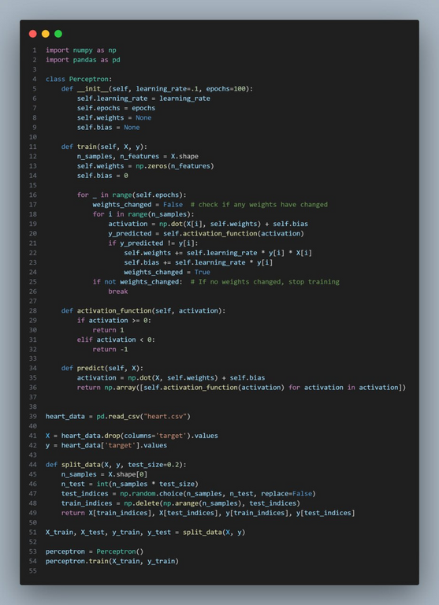
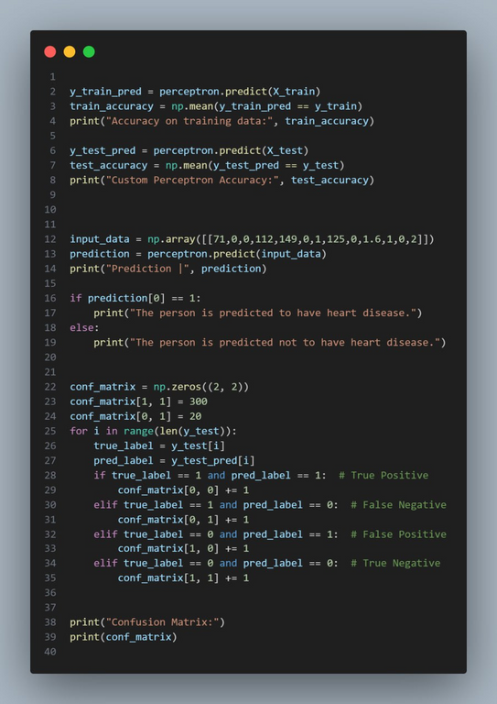
THE SINGLE LAYER PERCEPTRON

Slide 11
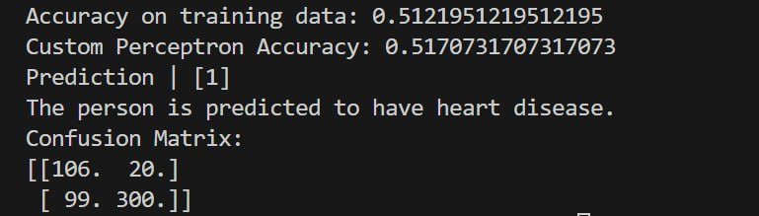
OUTPUT

Slide 12
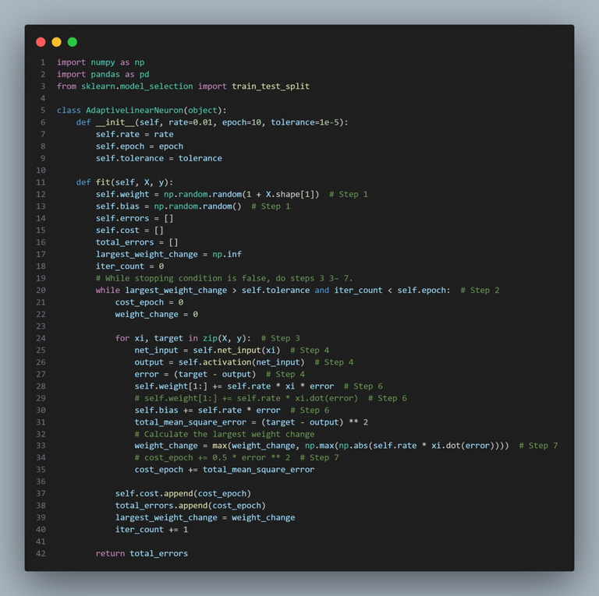
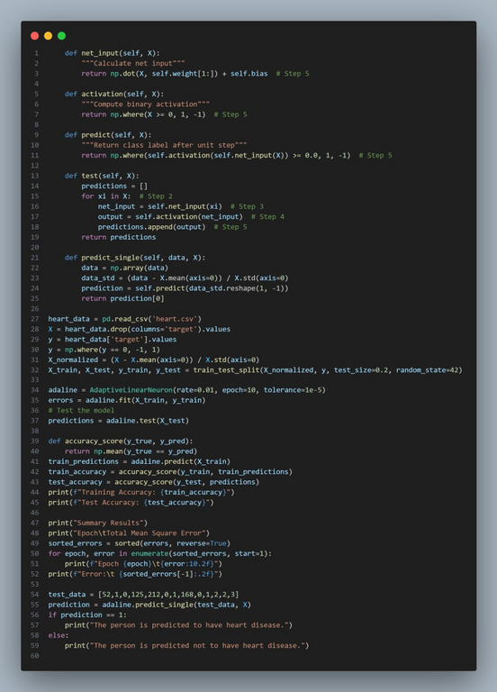
AdaptiveLinearNeuron

Slide 13
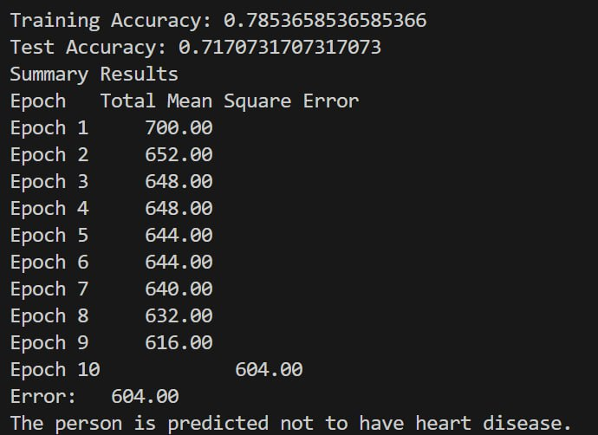
OUTPUT

Slide 14
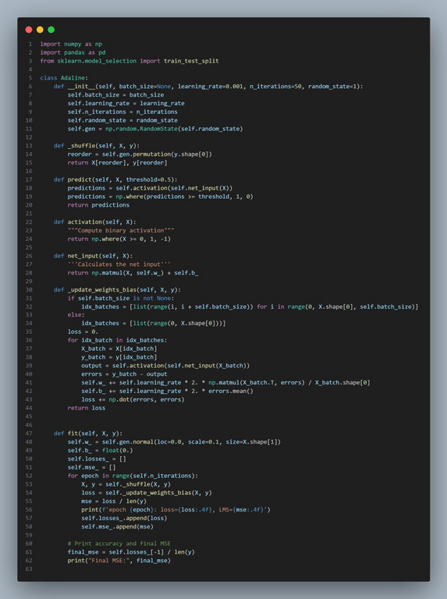
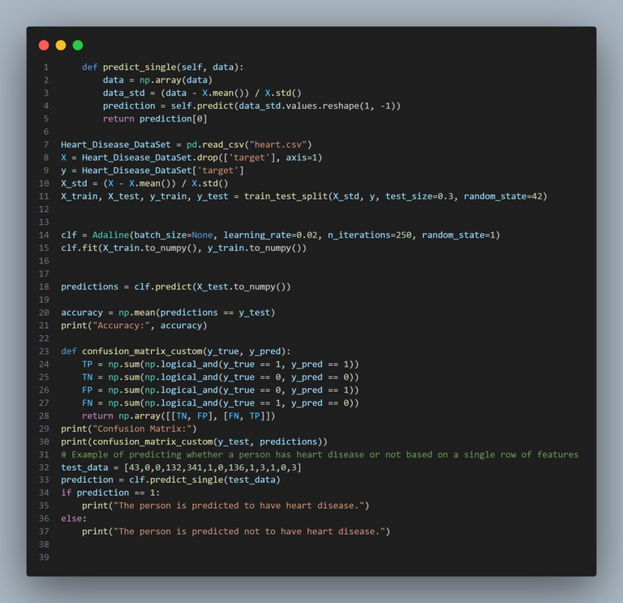
ADALINE 2

Slide 15
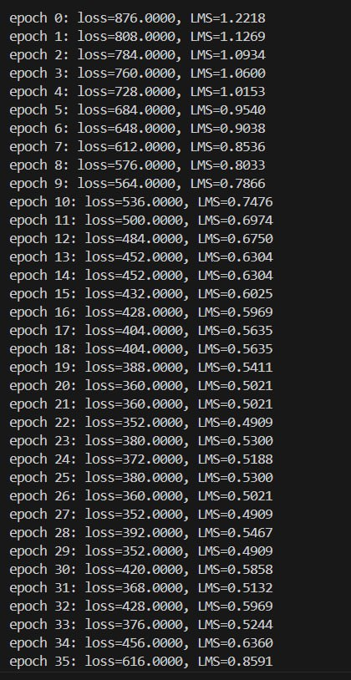
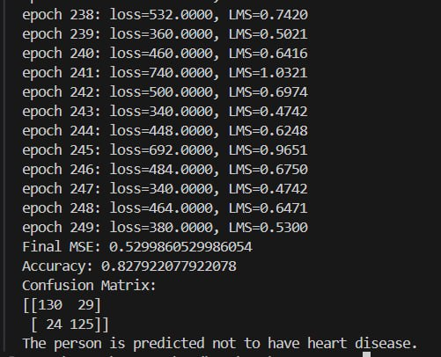
OUTPUT

Slide 16
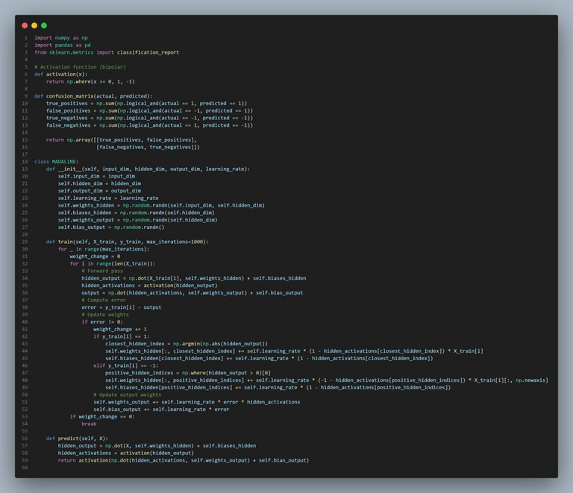
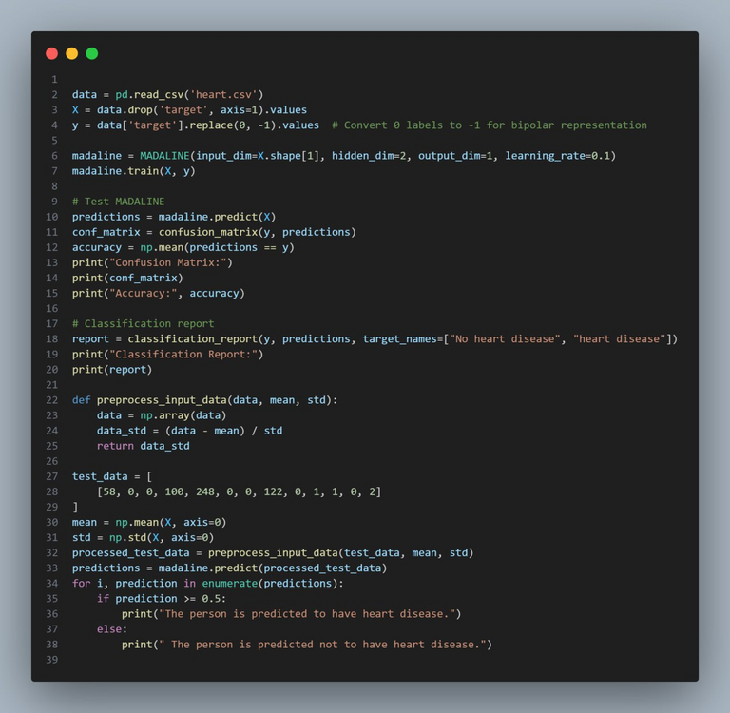
MADALINE (MRI)

Slide 17
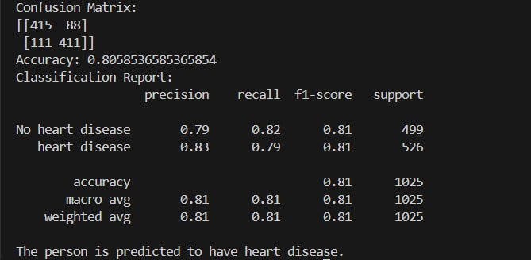
OUTPUT

Slide 18
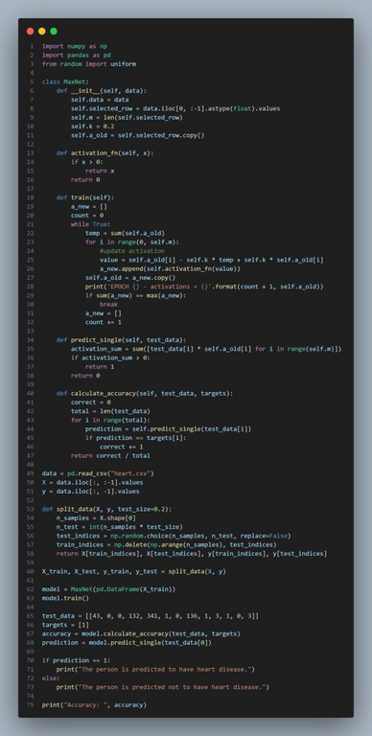
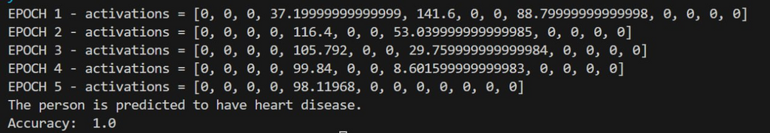
MAXNET
OUTPUT

Slide 19
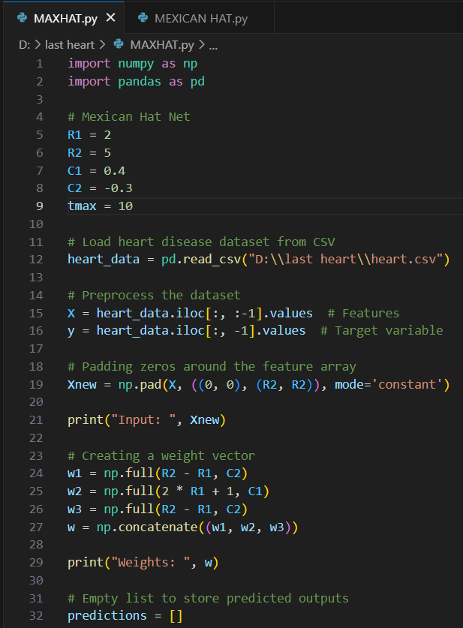
MEXICAN HAT

Slide 20
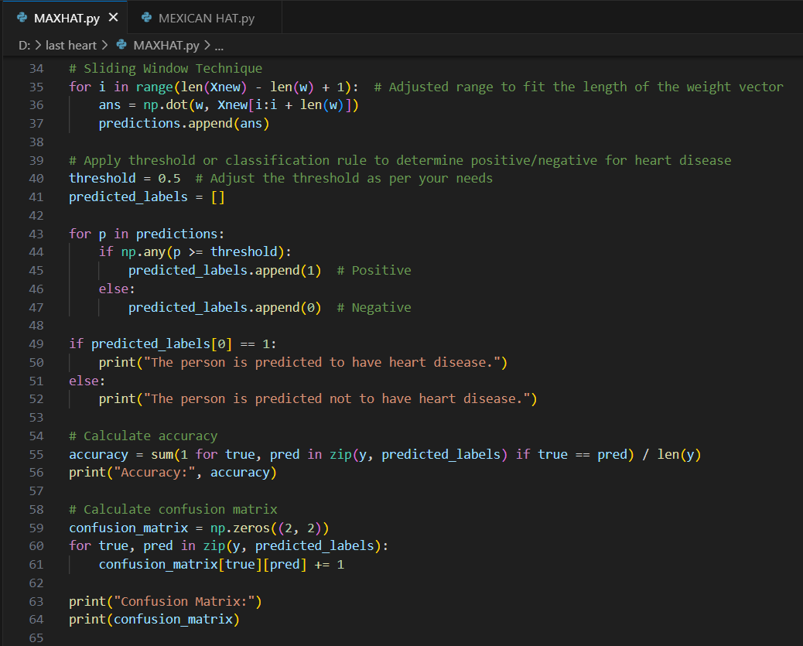
MEXICAN HAT

Slide 21
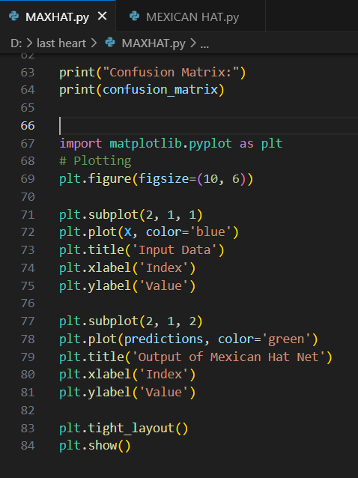
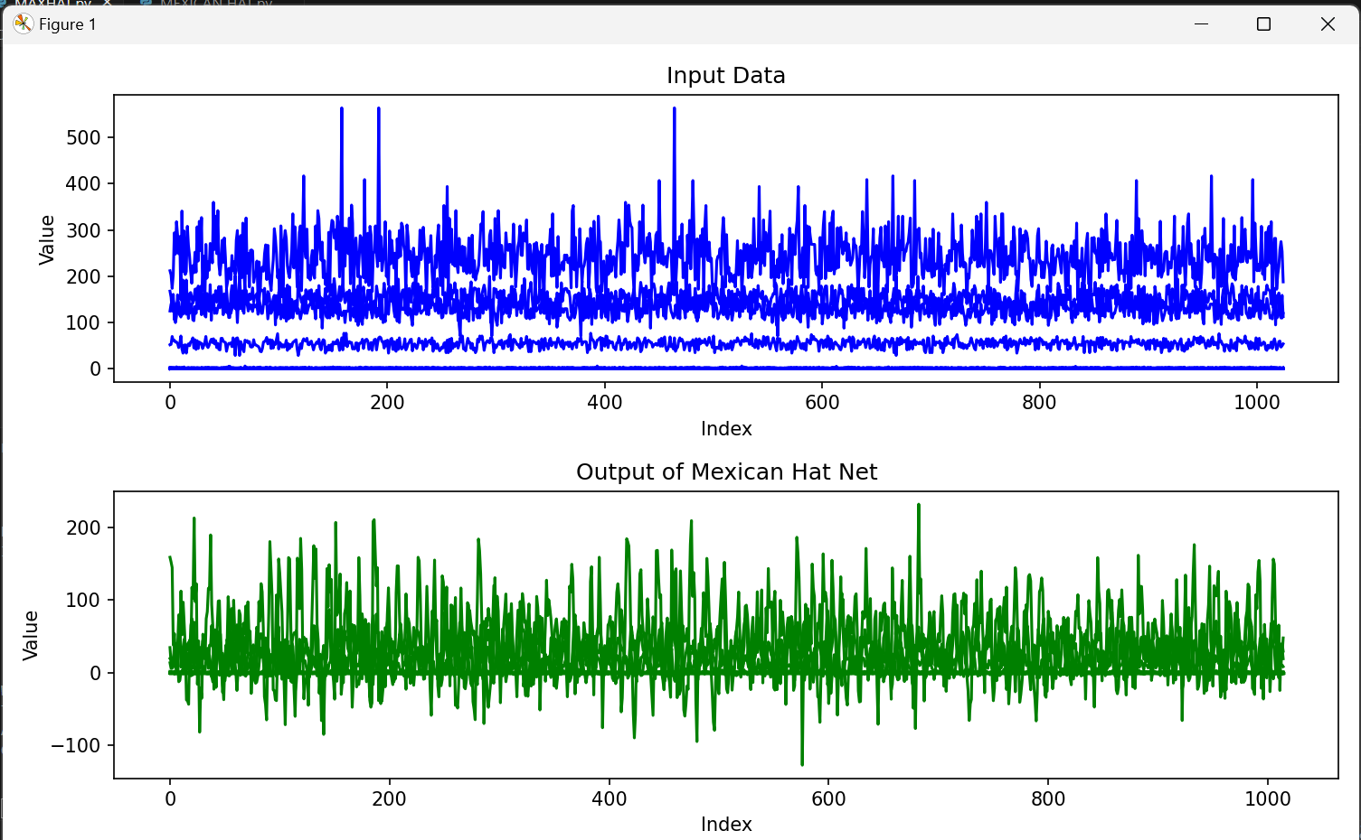
MEXICAN HAT
OUTPUT

Slide 22
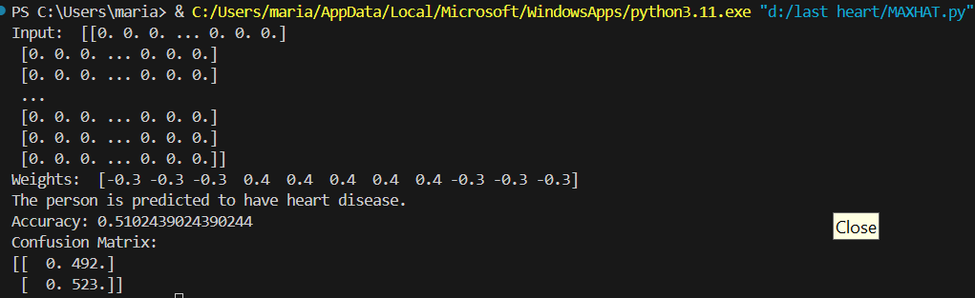
MEXICAN HAT

Slide 23
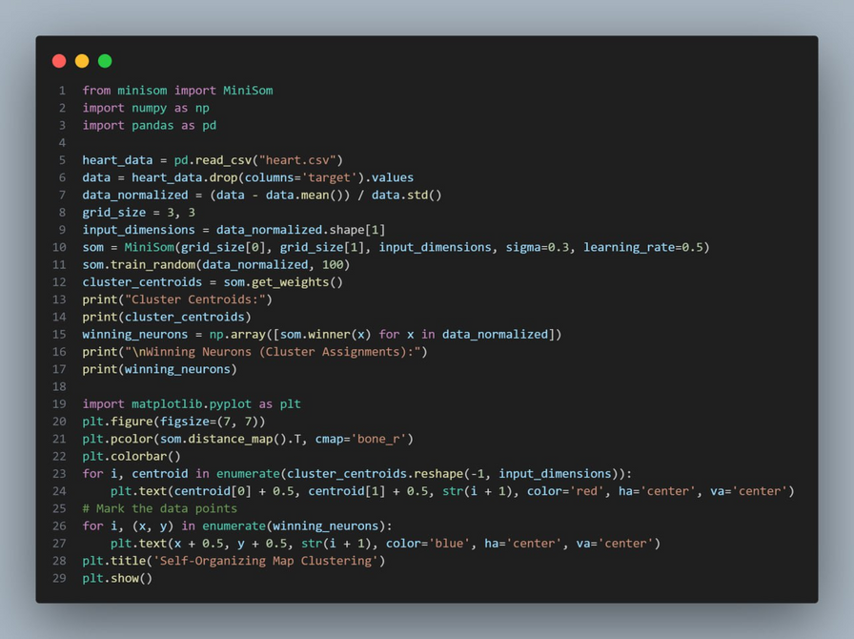
Self-Organizing Map

Slide 24
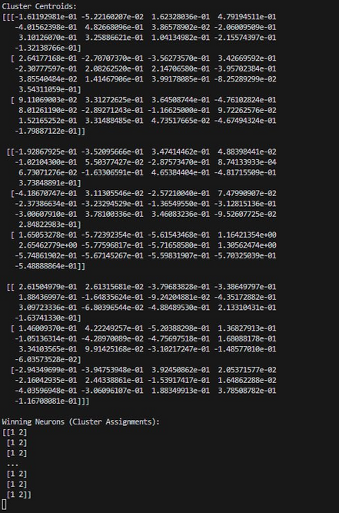
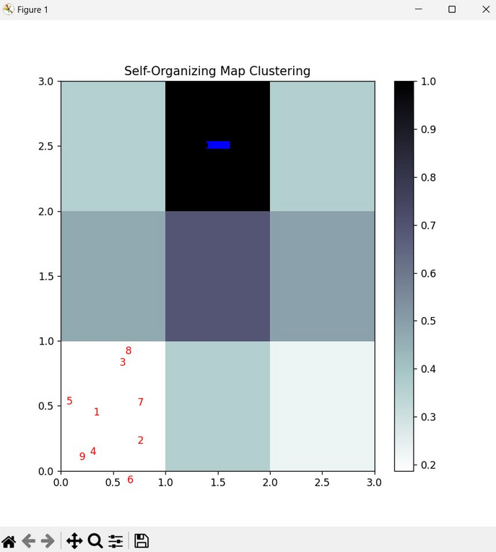
OUTPUT

Slide 25
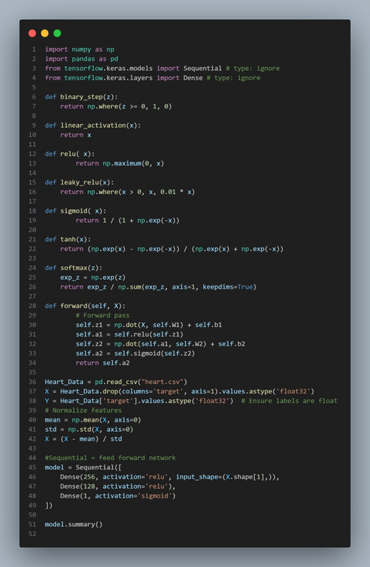
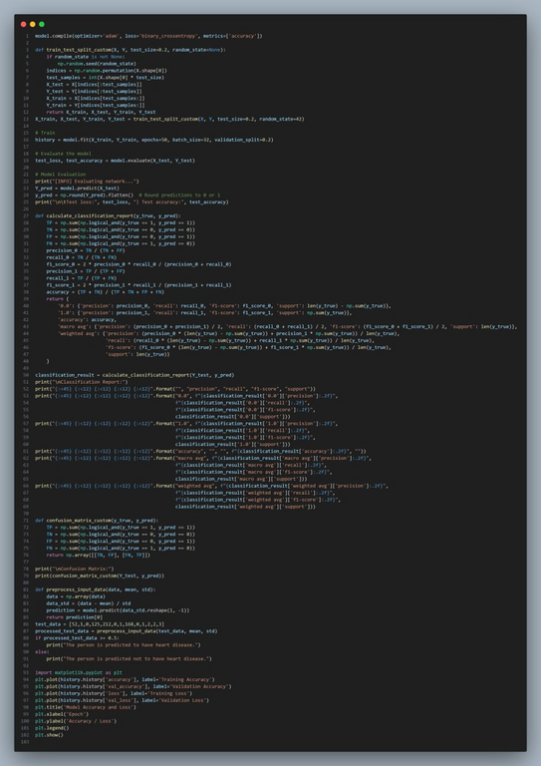
multilayer perceptron feedforward neural network

Slide 26
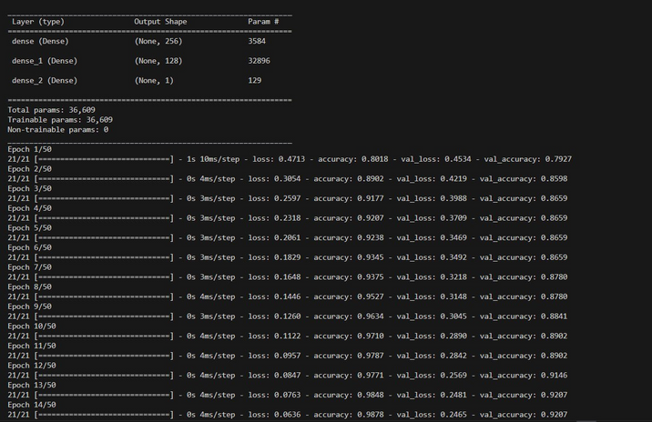
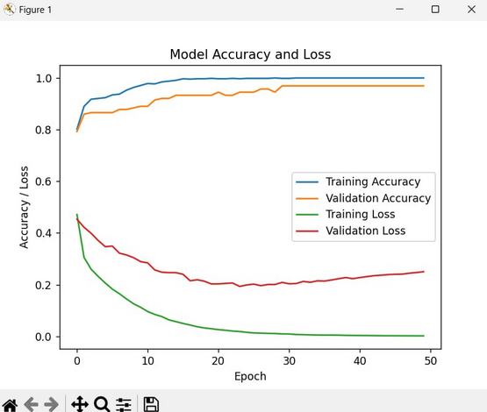
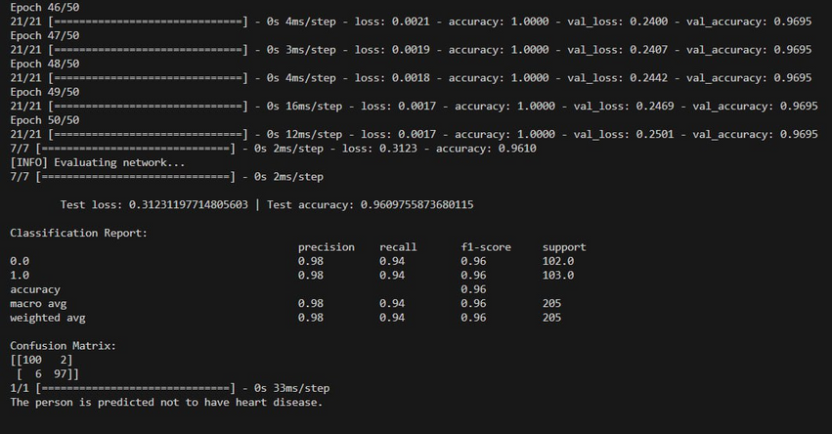
OUTPUT

Slide 27
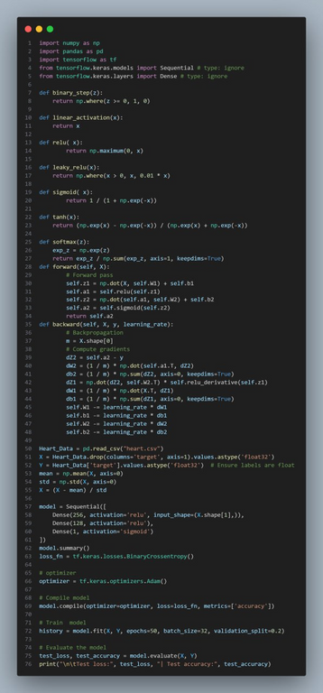
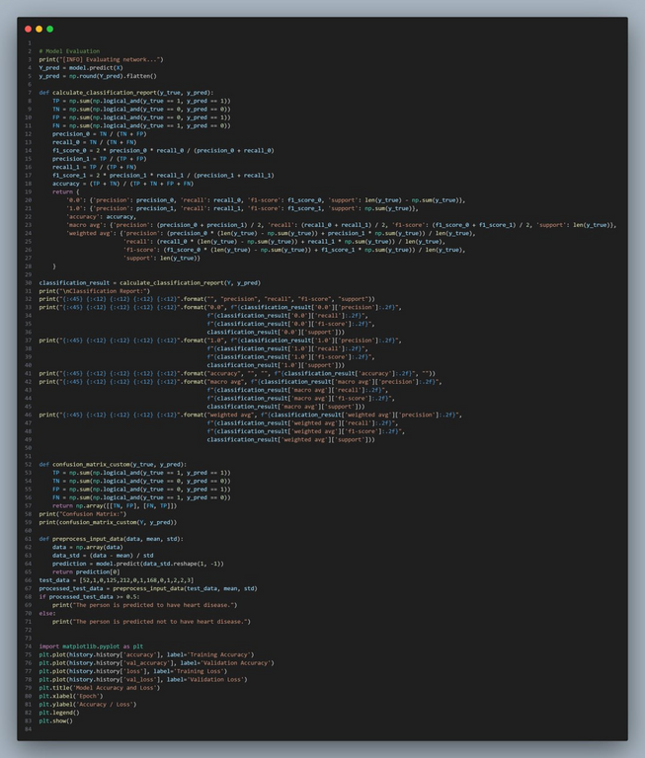
MULTILAYER PERCEPTRON BACKPROPAGATION NEURAL NETWORK

Slide 28
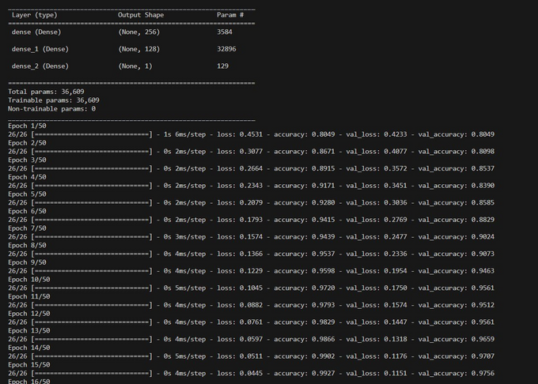
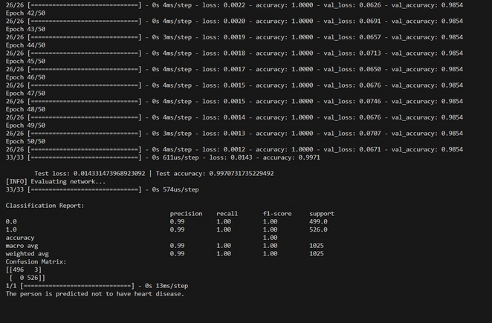
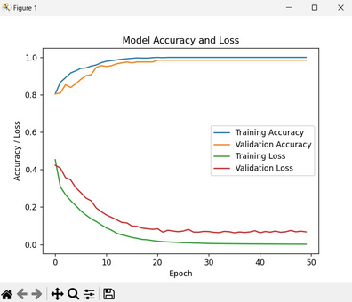
OUTPUT

Slide 29
Asmaa Mohamed noman
Rawan ahmed abd-elghafar
Alaa atef saafan
Aya sabry abd-elmoniem
Sara abd-Elkader
Maryam dawood
Team Members :

Slide 30
THANK YOU

